Slide 1



AgriMarket AI
"Empowering African Farmers with Smart Market Access"
By Emmanuel Kimaro
01

Slide 2

Problem Statement
Smallholder farmers lose 35% of produce to poor market access and logistics.
Middlemen take up to 60% of the farmer’s final selling price.
Lack of market price transparency keeps farmers in poverty.
Climate change impacts require better forecasting and planning tools.
10

Slide 3

Solution
AI-powered marketplace app linking farmers with buyers directly.
Real-time price tracking and predictive market analytics.
Smart logistics coordination to reduce waste.
Training and digitization support for rural farmers.
06

Slide 4



Product
Mobile & web platform (with USSD support for non-smartphone users).
Features:
Produce listing + bidding system.
Predictive pricing using machine learning.
GPS-based logistics support.
Payments and transaction records (via M-Pesa).
04

Slide 5



Target Market
3 out 5
Primary: Smallholder farmers (Kenya, Uganda, Tanzania).
95%
Secondary: Bulk buyers, supermarkets, agro-exporters.
123 million
Tertiary: NGOs & gov’t programs supporting agricultural supply chains.
14

Slide 6
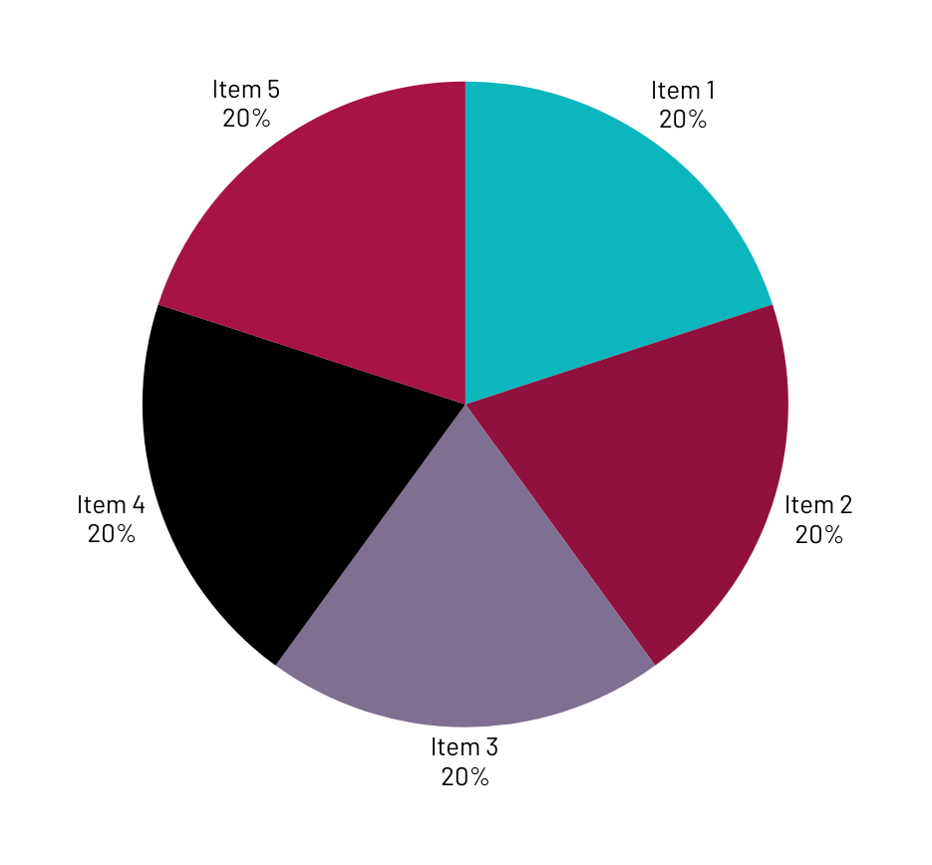
Market Size
Total Addressable Market (TAM)
"East Africa’s agriculture market is valued at $40 billion annually."
Serviceable Available Market (SAM)
"Out of this, $3 billion is transacted via mobile-accessible B2B trading."
Serviceable Obtainable Market (SOM)
"We aim to capture $20 million worth of produce trade within 3 years."
Growth Rate of Market
"Agri-tech in Africa is growing at 15% annually, driven by mobile and AI adoption."
Validation (Why Now?)
Rising food insecurity and government digital agriculture policies create urgent demand for platforms like ours."

Slide 7
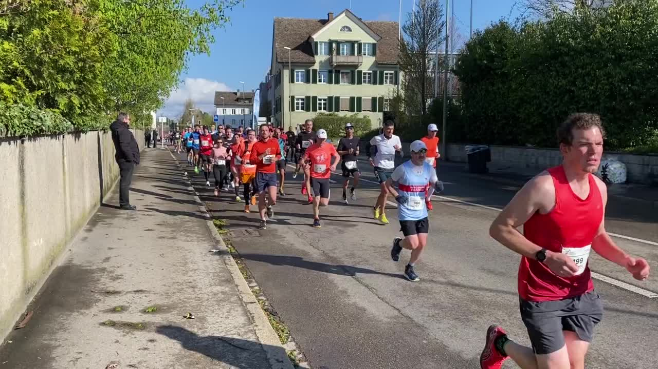
Competitors
Twiga Foods connects farmers to vendors but focuses on urban delivery and lacks AI-powered insights.
iProcure handles agro-input logistics, not post-harvest market access.
FarmDrive offers farm credit scoring, but doesn’t enable produce sales.
Our Edge:
We combine market access, price prediction, and smart logistics in one platform tailored for smallholder farmers in rural areas. No one else in the region offers this full-stack solution.
23

Slide 8

Competitive Advantage
AgriMarket AI offers an all-in-one solution combining AI-powered pricing, direct farmer-to-buyer trading, and logistics optimization, tailored specifically for smallholder farmers in rural East Africa. While others focus on isolated problems, we integrate the entire agricultural supply chain into one smart, scalable platform.

Slide 9
Project Traction
Tasks
Month 1
Month 2
Month 3
Month 4
Month 5
Build MVP
Sign Partners
Launch Pilot
Train Farmers
Collect Feedback
Improve Platform
Expand Reach and sign buyers
Scale Operations and demo pitch
23

Slide 10

Business Model
Commission Model: 5–7% per transaction.
Premium Buyer Accounts: Subscription-based features.
Freemium Training: Basic access free, premium AI tools paid.
Profit Margin Goal: 30–35% after year 2.
23

Slide 11
Go To Market
Partner with farmer cooperatives and SACCOs for bulk onboarding.
Use extension officers and agri-NGOs as local ambassadors.
Regional radio campaigns plus SMS blasts to reach rural users.
Begin pilot in Kisii, Kenya and scale to 3 counties in 6 months.

Slide 12
Social Impact
The following sustainable development goals based by the United Nations will be achieved:
SDG 1: No Poverty
SDG 2: Zero Hunger
SDG 9: Industry, Innovation & Infrastructure
SDG 12: Responsible Consumption & Production
SDG 13: Climate Action (via reduced waste)

Slide 13
Our Ask
$75,000 seed funding.
Use of Funds:
40% – Platform development and AI tools.
30% – Farmer training and onboarding.
20% – Marketing and local partnerships.
10% – Legal + compliance setup.

Slide 14

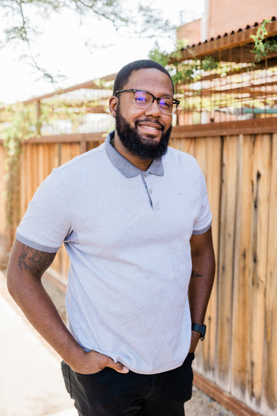


Team Members
Add team members Names and tiles
VERONICA
ENOCK
RAMADHAN
EMMANUEL
Project Manager
Assistant Director
Financial Architect
CEO

Slide 15



Thank you!
PHONE: +254713442011
EMAIL: EMMANUELSAMUEL2523@GMAIL.COM
17

